Slide 1
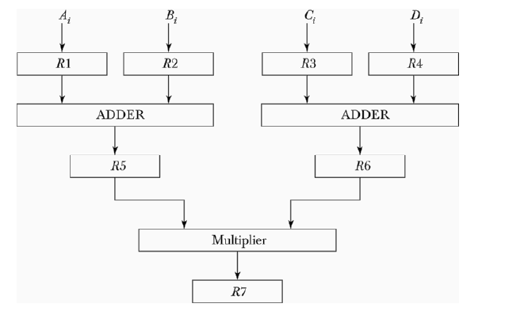
PROBLEMS
Based on M. Morris Mano “Computer System Architecture”--Assist. Lecturer Ahmed Salah Hameed

Slide 2
PROBLEMS
Based on M. Morris Mano “Computer System Architecture”--Assist. Lecturer Ahmed Salah Hameed

Slide 3
PROBLEMS
Based on M. Morris Mano “Computer System Architecture”--Assist. Lecturer Ahmed Salah Hameed

Slide 4
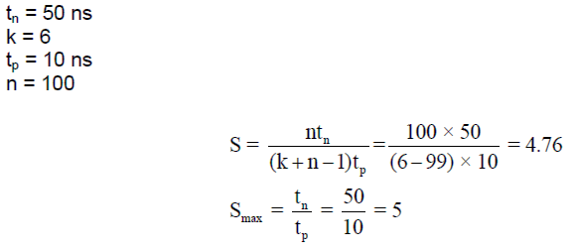
PROBLEMS
Based on M. Morris Mano “Computer System Architecture”--Assist. Lecturer Ahmed Salah Hameed

Slide 5
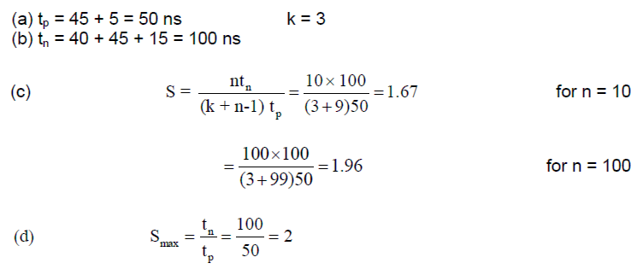
PROBLEMS
Based on M. Morris Mano “Computer System Architecture”--Assist. Lecturer Ahmed Salah Hameed

Slide 6
PROBLEMS
Based on M. Morris Mano “Computer System Architecture”--Assist. Lecturer Ahmed Salah Hameed

Slide 7
PROBLEMS
Based on M. Morris Mano “Computer System Architecture”--Assist. Lecturer Ahmed Salah Hameed

Slide 8
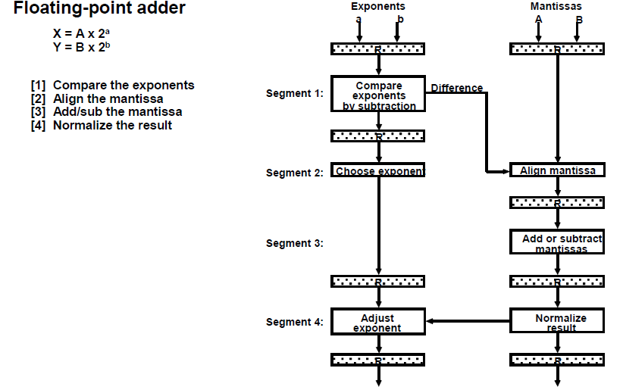
PROBLEMS
Based on M. Morris Mano “Computer System Architecture”--Assist. Lecturer Ahmed Salah Hameed

Slide 9
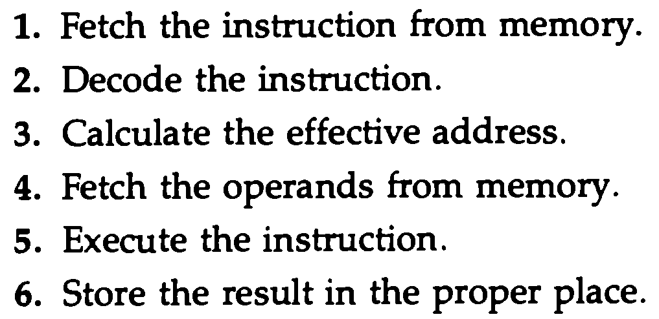
PROBLEMS
Based on M. Morris Mano “Computer System Architecture”--Assist. Lecturer Ahmed Salah Hameed

Slide 10
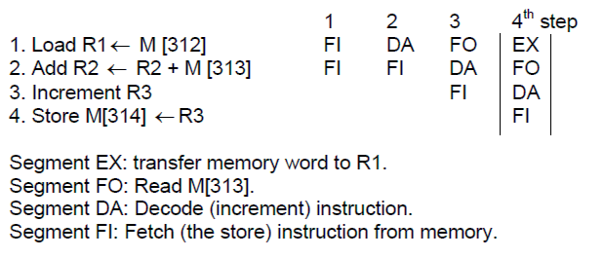
PROBLEMS
Based on M. Morris Mano “Computer System Architecture”--Assist. Lecturer Ahmed Salah Hameed

Slide 11
PROBLEMS
Based on M. Morris Mano “Computer System Architecture”--Assist. Lecturer Ahmed Salah Hameed

Slide 12
PROBLEMS
Based on M. Morris Mano “Computer System Architecture”--Assist. Lecturer Ahmed Salah Hameed

